Slide 1

Research Mentor Training Class 2: Understanding Ethics Diversity
Tammy R. L. Collins, Ph.D.

Slide 2
Overview
Confidentiality: This is important for open discussions and everything discussed remains confidential

Slide 3
Intros
Share your paragraph with your neighbor or read from the list provided
Does it make sense to you? Any jargon or is it too technical?
Any other communication tools they should use
Are the expectations clear
Comments on the mentoring philosophies
Positive and negative comments
How did reflecting on those comments feel?

Slide 4
Assessing Understanding
You have recently explained a complicated computational technique to your mentee. As you were explaining, he nodded the entire time as if he understood every word you were saying. When you were finished with your explanation, you asked him if he had any questions. He said no. Just to make sure, you asked him if everything was clear. He said yes. Three days later you asked the mentee how his work using this technique was going and he told you he hasn’t started because he does not understand the technique.
What can you do in the future to make sure your mentee understands what you are saying?

Slide 5
Discuss in Pairs/Groups
Here are some things to think about
Best ways to see if they understand
How often to check in
What other reasons could influence if they understand you
Do you need a different communication tool
Balance independence with understanding
How do power dynamics fit in here
How can you provide more steps to understanding (break down the thought processes)
https://ictr.wisc.edu/mentoring/mentors-cultivation-phase-resources/
Notes:
https://mentoringresources.ictr.wisc.edu/MentorsAssessingUnderstanding
https://www.aps.org/programs/education/undergrad/faculty/upload/Physics-Research-Mentor-Training-Seminar.pdf

Slide 6
Ethics
Why bother talking about it?
1 in 3 scientists responding anonymously to surveys admits to “questionable” research practices
News headlines over the past few years
UK legalizes three-parent babies (MRT) | US Panel
The Scientist-scientific misconduct-PubPeer
First Primates Cloned
CRISPR babies
First US Trial of CRISPR in humans
Notes:
http://www.the-scientist.com/?articles.view/articleNo/41718/title/Top-Science-Scandals-of-2014/
http://www.the-scientist.com/?articles.view/articleNo/44895/title/The-Top-10-Retractions-of-2015/
http://www.the-scientist.com/?articles.view/articleNo/47813/title/Top-10-Retractions-of-2016/
https://www.the-scientist.com/?articles.view/articleNo/51195/title/Top-10-Retractions-of-2017/
2. It’s every researcher’s worst nightmare: a manuscript gets rejected during peer review, then shows up later—published by one of the reviewers. Michael Dansinger of Tufts Medical Center took his heartache into his own hands, publishing a letter to the reviewer who stole his paper in the Annals of Internal Medicine, the journal that had originally rejected his manuscript during review. (The reviewer’s version of the paper—which contained the lifted work—was retracted in September.)
https://www.scribd.com/document/322854876/19112726351#download&from_embed
http://orei.unimelb.edu.au/content/fabrication-falsification-plagiarism
https://pubpeer.com/publications/75A408EDAE59ECCAF54B6BB36E42D6#fb51858
http://www.nature.com/news/should-you-edit-your-children-s-genes-1.19432
PubPeer started in 2012 (https://pubpeer.com) | users can comment anonymously or reveal themselves to comment on published research | has led to a number of retractions, but also a major lawsuit against PubPeer.
https://ori.hhs.gov/definition-misconduct

Slide 7
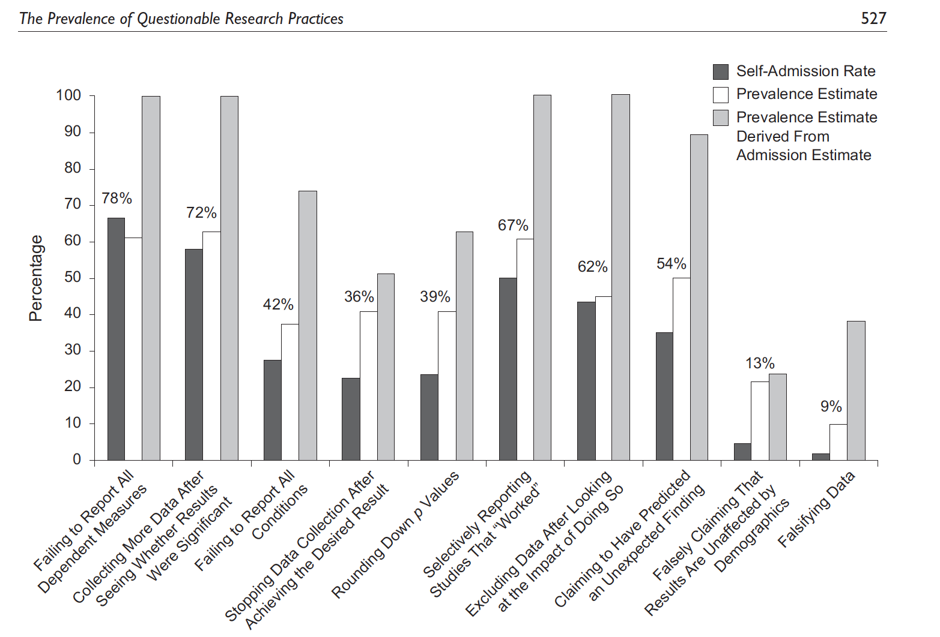
https://www.cmu.edu/dietrich/sds/docs/loewenstein/MeasPrevalQuestTruthTelling.pdf

Slide 8
Ethics
What is:
Falsification
Fabrication
Plagiarism (“just use this text”)

Slide 9
John is mentoring an undergraduate in his lab, and has assigned her to collect data for one of the experiments in his dissertation. When the dataset is complete, he sits down to analyze it and finds his predictions completely disconfirmed. Dismayed, he calls her into his office and asks her to describe, in great detail, what she did when collecting the data. He wants to make sure that these anomalous results can't be more easily explained by mistakes in the lab. Their conversation lasts quite a while, but at the end he is still frustrated and puzzled by the data, and he sends her home so he can think about it some more.
Later, John is eating lunch in the cafeteria when he overhears his mentee talking to a friend of hers. "I think John is mad at me," she tells her friend, visibly upset, and describes their recent meeting. John is surprised to realize that his mentee took his questioning very personally. When John's mentee finishes venting, her friend replies, "If he's so mad, you probably did make a mistake somewhere. After all, he's the expert. Maybe you should tweak the data a little next time to keep him happy."

Slide 10
Drivers of Misconduct
Notes:
NIH ORI Quotes from closed case studies

Slide 11
How Do You Plan to Talk to a Mentee?
Lab notebooks/record keeping
Data analysis
Great case studies at: NIH Office of Research Integrity: https://ori.hhs.gov/case_summary
You make up an integral part of establishing good ethical practices
Notes:
http://ori.hhs.gov/case_summary

Slide 12
Diversity
What is diversity?
Types of differences specific to research/education?
How does diversity in America differ from other countries?
What are some issues in your country?
How does a person’s background influence their experiences?
https://www.youtube.com/watch?v=3Nj-MjBc-xQ
https://implicit.harvard.edu/implicit/
Notes:
https://www.youtube.com/watch?v=2RSVz6VEybk
https://implicit.harvard.edu/implicit/

Slide 13
Meaning is Attributed to Difference
The ‘Norm’ (Agent)
Members of dominant social groups in the U.S., privileged by birth or acquisition, which knowingly or unknowingly exploit and reap unfair advantage over members of groups that are targets of oppression
The ‘Other’ (Target)
Members of social identity groups that are disenfranchised, exploited, and victimized in a variety of ways by agents of oppression and the agent’s systems or institutions.
Subject to containment, compartmentalized into narrowly defined roles

Slide 14
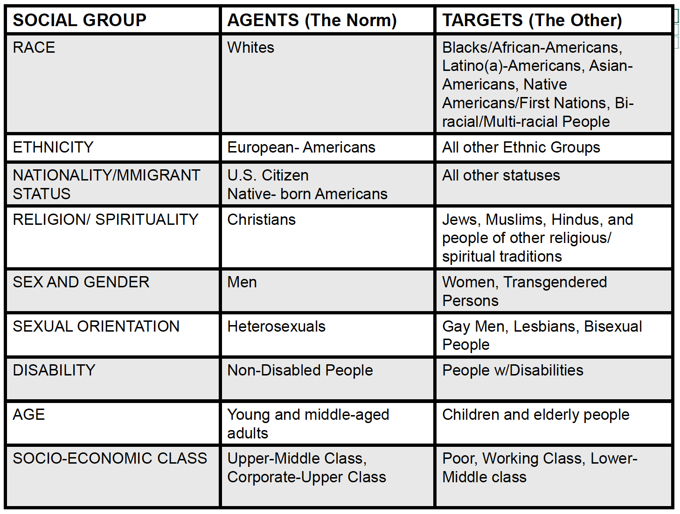

Slide 15
Important Definitions (I)
Stereotype: an exaggerated belief, image or distorted truth about a person or group; a generalization that allows for little or no individual differences or social variation.
Prejudice: an opinion, prejudgment or attitude about a group or its individual members.
Discrimination: is behavior that treats people unequally because of their group memberships. Discriminatory behavior, ranging from slights to hate crimes, often begins with negative stereotypes and prejudices.
http://www.tolerance.org/activity/test-yourself-hidden-bias

Slide 16
Important Definitions (II)
Social Power: Access to resources that enhance one’s chances of getting what one needs or influencing others in order to lead a safe, productive, and fulfilling life.
Privilege: Unearned access to resources (social power) or advantages only readily available to some people as a result of their social group membership.
Inequality: Unequal access to resources and power needed to lead a safe, productive, and fulfilling life (e.g., haves vs. have-nots; powerful vs. powerless).

Slide 17
A Mentor Committed to Diversity:
Spends time identifying their diversity blind spots and seek accurate information and knowledge
Understands that getting to know individuals is key to becoming a strong ally
Cultivates “respectful curiosity”; appreciates that this skill takes practice and that mistakes are inevitable
Becomes knowledgeable about laws and regulations that impact diversity
Uses inclusive language and images
Notices stereotyping and actively work against it https://www.youtube.com/watch?v=failylROnrY
Works to broadly advertise available positions
Defines/implements hiring processes to minimize the impact of personal biases
Makes their work environments accessible and free of mobility barriers
Attends programs focused on cultural diversity (with staff); listen and learn
Pays attention to diversity and cross-cultural training
Supports the development of diversity and affinity groups at their institution
Supports institutional programs that promote diversity and inclusion
Models good behavior and addresses diversity issues within the workgroup with respect and candor

Slide 18
Last summer I worked with a fantastic undergraduate mentee. She was very intelligent and generated a fair amount of data. I think that she had a positive summer research experience, but there are a few questions that still linger in my mind. This particular mentee was an African-American woman from a small town. I always wondered how she felt on a big urban campus. I also wondered how she felt about being the only African-American woman in our lab. In fact, she was the only African-American woman in our entire department that summer. I wanted to ask her how she felt, but I worried it might be insensitive or politically incorrect to do so. I never asked. I still wonder how she felt and how those feelings may have affected her experience.
Notes:
1.
What are the main themes raised in this case study?
2.
What kind of conversations regarding expectations might have been helpful early in this
relationship?
3.
What kind of conversations would be helpful once the student asked for a different proj-
ect? Who should be involved in these conversations?
Questions for reflection:
How do you establish and communicate your expectations to your student?
How do you find out what expectations your student has of you and of his or her research experience?
When choosing a project for your student, how do you weigh their interest with the immediate needs of the research PI or group?
As a co-mentor, what should you do if a student does not like the project?
How do you assess your student's skills so you can choose an appropriate project?
What do you do if your student isn't making progress? How might you modify the project, and/or your expectations, if a student is having challenges?

Slide 19
Additional Questions
Has your gender ever impacted your experience as a mentee?
How does this compare to asking about race and ethnicity?
Would you be comfortable giving an underrepresented student and application for a scholarship targeted at minorities?
REFLECTION/DISCUSS IN PAIRS: Please reflect on a time you felt like you were in the minority. How did it make you feel?

Slide 20
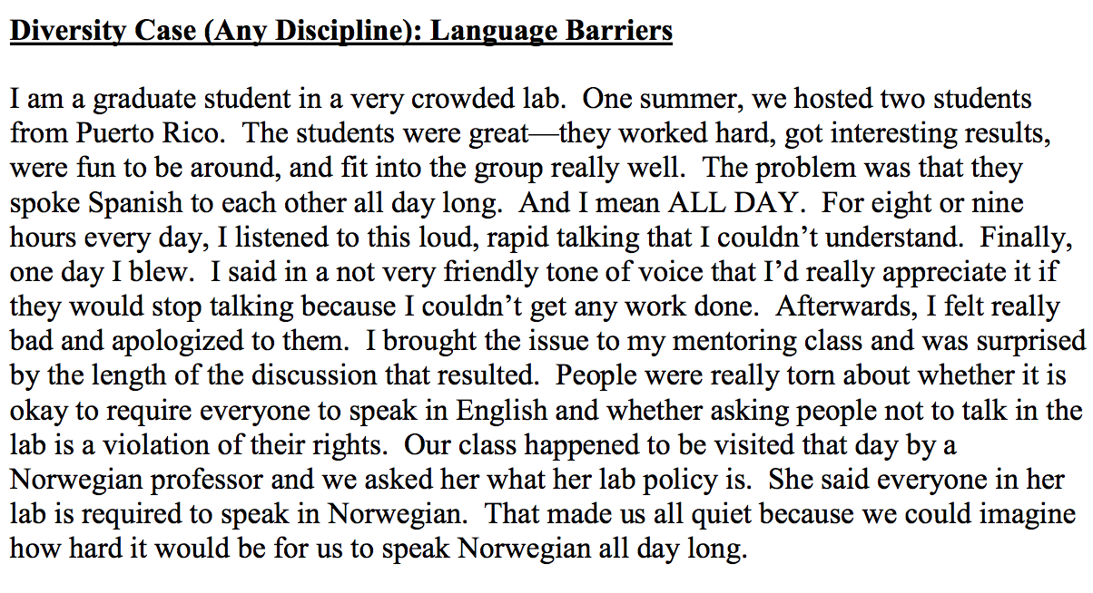

Slide 21
Diversity Scenarios
Discuss in pairs

Slide 22
HOMEWORK: Due Thursday at Noon
Group homework:
How do you differentiate a mentee who doesn’t understand vs one who doesn’t try?
On your own:
Talk about ethics with the youngest member of your group (what do they know about sci ethics, why it is important, and perhaps share a case study). Summarize your discussion.
Write a reflection on how you and your mentee (or past mentees) differ and how those differences could/did impact your relationship

Slide 23
Thanks to the NIH Office of Intramural Training & Education!
These slides are adapted from slides provided by OITE

